Slide 1
Shared PD and MR
Yuval Shaia <yuval.shaia@oracle.com>
Oracle 2019

Slide 2
Credits
Shamir Rabinovitch <srabinov7@gmail.com>

Slide 3
Agenda
Motivation
API
Usage
Implementation
Future Plans

Slide 4
Motivation - problem
Process
Process
Process
Process
Memory
Process
Thousands processes
Each one creates one or more MRs
HCA has to maintain thousands MRs
HCA

Slide 5
Motivation – alternative design
Process
Process
Process
Process
Process
Memory
Process
Thousands processes
One process creates huge MR and share it with all other processes
HCA has to maintain only one MR
HCA

Slide 6
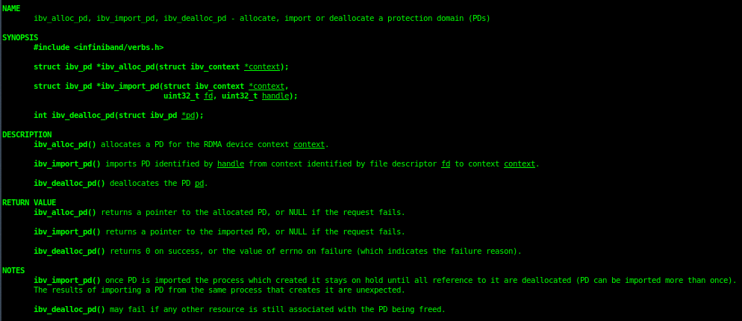
API – Import PD

Slide 7
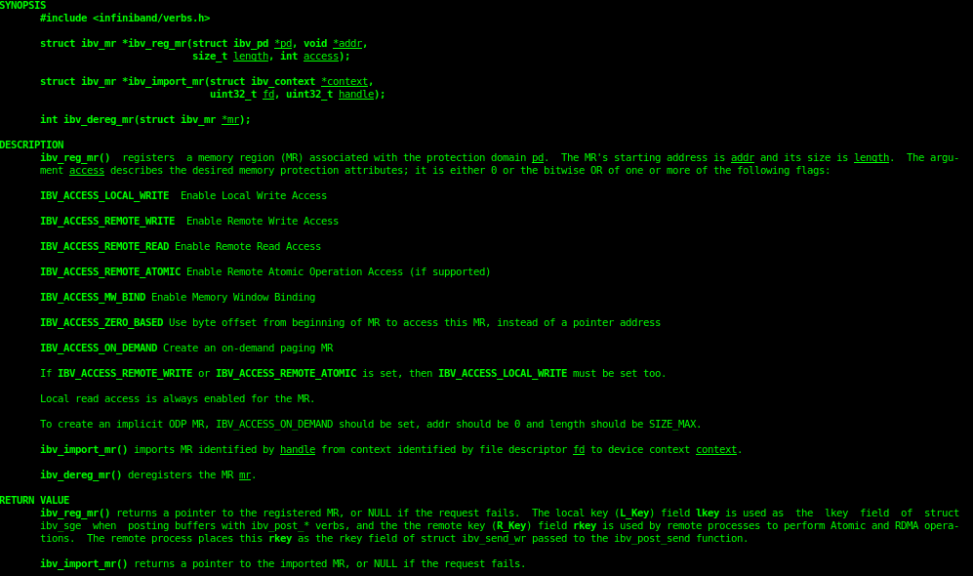
API – Import MR

Slide 8
Usage – process #1 (producer)
Create shared memory
Create IB context
Create PD and MR (with the shared memory)
Write the FD of the IB context in a SCM_RIGHTS message to the socket

Slide 9
Usage – process #2 (consumer)
Attach to the shared memory
Create IB context
Read the FD of process #1’s IB context from the socket
Read from shared memory the Ids of the PD and MR (optional)
Import PD and MR from the imported IB context to current IB context

Slide 10
Implementation
New verb – Import from FD
Currently implemented with “write”, switching to “ioctl”
A new user object is created which points to the same HW object of the one we are importing from
The HW object’s reference count is increased
As with HW object creation – the vendor specific attributes are copied from src to dst
When HW object is destroyed (ex dealloc_pd) the user object is destroyed and HW object’s ref count is updated.
HW object is destroyed only when reached to zero references

Slide 11
Submission status
Preparation patch-set is under review (cleanup of uobj from HW objects)
Under work – switching to ioctl

Slide 12
Future Plans
Review import PD and import MR patch-sets
Import from shared memory
Evaluate sharing of other objects

